Slide 1
Chapter 2-2
Structured Cabling
(6 Subsystems)
How the Wires Run from Building Entrance to Actual Usage?

Slide 2
TIA/EIA 568-A (year 1995)
Association
Alliance
The first major standard describing a structured cabling system for computer networks was the TIA/EIA 568-A in 1995. (A comes first; B came 2000)
TIA stands for the Telecommunications Industry Association, which is a trade organization that represents the interests of the telecommunications industry.
EIA is the Electronics Industries Alliance a trade organization that lobbies for the interests of manufacturers of electronics related equipment.
Summary:
568A (1995);
568A Addendum 5 (1999) ;
568B (2000)

Slide 3
TIA/EIA 568-A (year 1__5)
Association
Alliance
The first major standard describing a structured cabling system for computer networks was the TIA/EIA 568-A in 1995. (A comes first; B came 2000)
TIA stands for the T_____________s I_____y A_________n, which is a trade organization that represents the interests of the telecommunications industry.
EIA is the E________s I_______es A_____ce a trade organization that lobbies for the interests of manufacturers of electronics related equipment.
Summary:
568A (1__5);
568A Addendum 5 (1__9) ;
568B (2__0)

Slide 4
TIA/EIA 568-A (year 1995)
Association
Alliance
The first major standard describing a structured cabling system for computer networks was the TIA/EIA 568-A in 1995. (A comes first; B came 2000)
TIA stands for the Telecommunications Industry Association, which is a trade organization that represents the interests of the telecommunications industry.
EIA is the Electronics Industries Alliance a trade organization that lobbies for the interests of manufacturers of electronics related equipment.
Summary:
568A (1995);
568A Addendum 5 (1999) ;
568B (2000)

Slide 5
Questions
What do the following terms stand for?
TIA
EIA
When was TIA/EIA 568 A cabling system established?

Slide 6
Answers
What do the following terms stand for?
TIA – Telecommunications Industry Association
EIA – Electronics Industries Alliance
When was TIA/EIA 568 A cabling system established? - 1995

Slide 7
Answers
What do the following terms stand for?
TIA – Telecommunications Industry Association
EIA – Electronics Industries Alliance
When was TIA/EIA 568 A cabling system established? - 1995

Slide 8
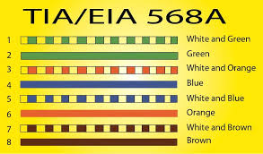
Solid Blue
Solid Brown

Slide 9
EIA/TIA 568-A Addendum 5 (5e) (year 1999)
The most important addendum to the EIA/TIA 568-A standard was Addendum 5, published in 1999.
This addendum defined the transmission performance specifications for 4-pair 100 ohm Category 5e twisted-pair cabling.
This is the type of cabling recommended for use in today’s computer networks. (Actually CAT6 is the currently being recommended)
Impedance

Slide 10
What is defined by EIA/TIA 568-A Addendum 5 ? (year 1999)

Slide 11
What is defined by EIA/TIA 568-A Addendum 5 ? (year 1999)
Answer:
This addendum defined the transmission performance specifications
for 4-pair 100 ohm Category 5e twisted-pair cabling.
Impedance is 100 ohms

Slide 12
Campus Network (568-A)
The EIA/TIA 568-A standard defined the minimum requirements for the internal telecommunications wiring in buildings and between structures in a campus network.
A campus network consists of interconnected LANs within a limited geographic area such as a college campus, a military base, or a group of commercial buildings.

Slide 13
What is a Campus Network ?
What is the minimum requirement?
Answer
A Campus Network is a Network which is consisted of interconnected LANs within a limited geographic area such as a college campus, a military base, or a group of commercial buildings.
The EIA/TIA 568-A standard is the minimum requirement for the internal telecommunications wiring in buildings and between structures in a campus network.

Slide 14
What is a Campus Network ?
What is the minimum requirement?

Slide 15
What is a Campus Network ?
What is the minimum requirement?
Answer
A Campus Network is a Network which is consisted of i___terc____t_d L_Ns within a l___t_d g___gr____ic area such as a c______e c____s, a military base, or a group of commercial buildings.
The EIA/TIA 568-A standard is the minimum requirement for the internal telecommunications wiring in buildings and between structures in a campus network.

Slide 16
What is a Campus Network ?
What is the minimum requirement?
Answer
A Campus Network is a Network which is consisted of interconnected LANs within a limited geographic area such as a college campus, a military base, or a group of commercial buildings.
The EIA/TIA 568-A standard is the minimum requirement for the internal telecommunications wiring in buildings and between structures in a campus network.

Slide 17
EIA/TIA 568-B (year 2000) (3 parts)
in the year 2000 a new standard, the EIA/TIA 568-B was published. The three (3) parts of the EIA/TIA 568-B are as follows:
EIA/TIA-568-B.1 Commercial Cabling
EIA/TIA-568-B.2 Twisted Pair Media
EIA/TIA-568-B.3 Optical Fiber Cabling

Slide 18
EIA/TIA 568-B (year 2000) (3 parts)
in the year 2000 a new standard, the EIA/TIA 568-B was published. The three (3) parts of the EIA/TIA 568-B are as follows:
EIA/TIA-568-B.1 C___m___l Cabling
EIA/TIA-568-B.2 T_____d P__r Media
EIA/TIA-568-B.3 O____l Fiber Cabling

Slide 19
EIA/TIA 568-B (year 2000) (3 parts)
in the year 2000 a new standard, the EIA/TIA 568-B was published. The three (3) parts of the EIA/TIA 568-B are as follows:
EIA/TIA-568-B.1 Commercial Cabling
EIA/TIA-568-B.2 Twisted Pair Media
EIA/TIA-568-B.3 Optical Fiber Cabling

Slide 20
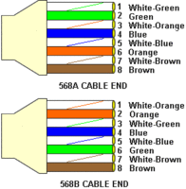
Cross-over Cable Connection: The A End and the B End
1
2
3
6

Slide 21
You must note:
Blue and Brown pairs are not changed
4 Blue
5 Blue & White
7 White & Brown
8 Brown

Slide 22
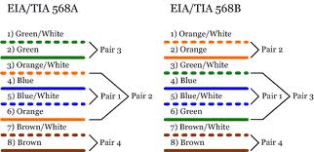
A Starts with Green/White
B Starts with Orange/White
Pairs 1 and 4 always remain the same: Pairs 2 and 3 are switching

Slide 23
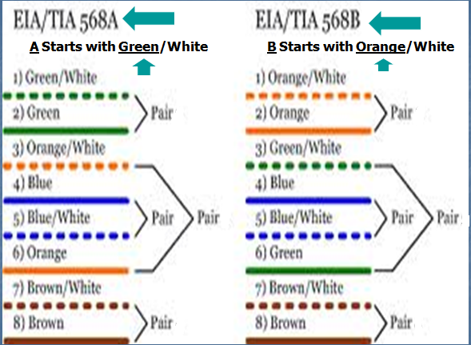
Identify The Pair Numbers in 568A and 568B In The Following:

Slide 24
A Starts with Green/White
B Starts with Orange/White
Pairs 1 and 4 remain the same; Pairs 3 and 2 are swapping between A and B.

Slide 25
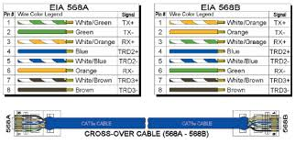
Another Example of Cross-over Cable
Green
The A End
The B End

Slide 26
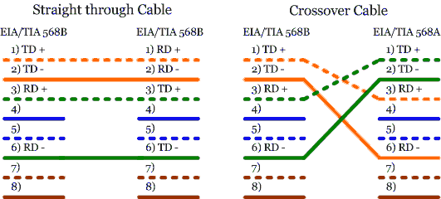
Straight Cable: Cross-over Cable:
B Both Ends are B One End B; Another End A
Figure 3: Straight through and crossover wiring schemes (10/100Base-T)

Slide 27
In Cross-over Cabling, Which Pairs Are Always The Same?
In Cross-over Cabling, Which Pairs Are Changing?

Slide 28
A Starts with Green/White
B Starts with Orange/White

Slide 29
In Cross-over Cabling Which Pairs Are Always The Same?
Answer: Pairs _ and _
In Cross-over Cabling Which Pairs Are Changing?
Answer: Pairs _ and _

Slide 30
In Cross-over Cabling Which Pairs Are Always The Same?
Answer: Pairs 1 and 4
In Cross-over Cabling Which Pairs Are Changing?
Answer: Pairs 3 and 2

Slide 31
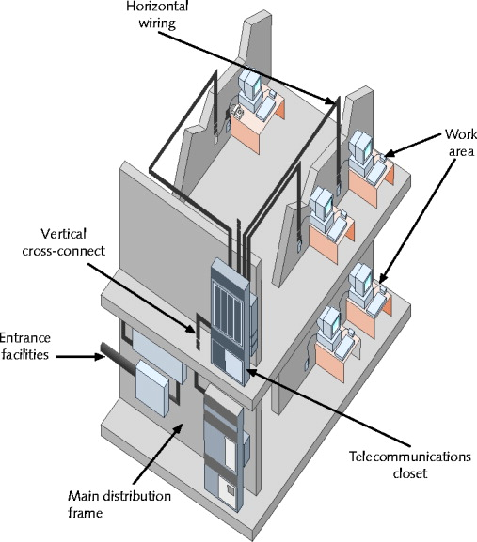
Work Outlet (Area)
HC
Horizontal Cabling
WO
VC
EF
Entrance Facilities
Main Distribution Frame (MDF)
Main Equipment Room (MER).
Campus Distributor (CD).
TC
Telecommunication Closet
MDF = MC= MER =CD
Figure 3-40 TIA/EIA structured cabling in a building

Slide 32
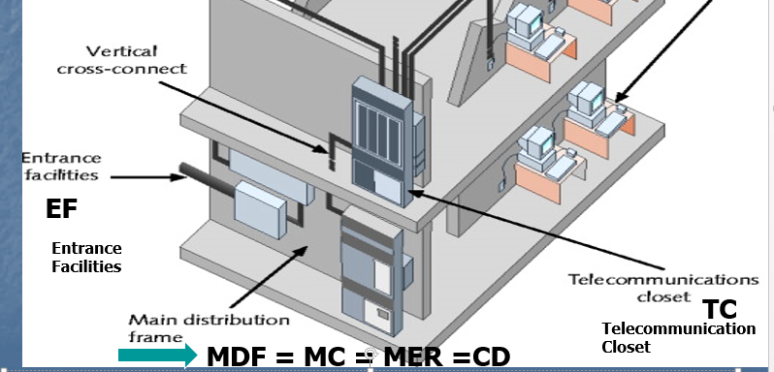
Main Distribution Frame (MDF)
The MC (Main Cross-connect) usually connects two or more buildings and it is typically the central telecommunications connection point for a campus or building. It is also called the Main Distribution Frame (MDF) or Main Equipment Room (MER). The MC connects to Telco, an ISP, etc. Another term for the MC is the Campus Distributor (CD).

Slide 33
Six (6) Subsystems of a Structured Cabling System Of EIA/TIA 568B
(1) Building Entrance (Entrance Facilities)
(2) Equipment Room (ER)
(3) Backbone Cabling
(4) Telecommunications Closet (TC)
(aka Telecommunications Room (TR) or
Telecommunications Enclosure (TE).
(TC = TR = TE)
(5) Horizontal Cabling (HC)
(6) Work Area (with Work Outlets [WO])

Slide 34
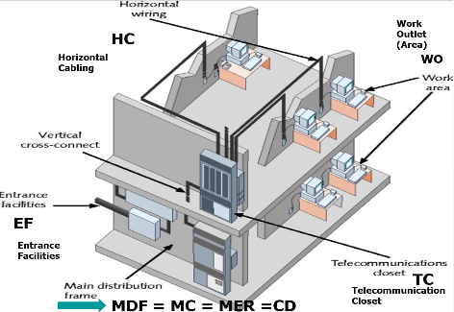
Major Acronyms
Building Entrance (Entrance Facilities) (EF)
Equipment Room (ER)
Telecommunications Closet (TC)
Telecommunications Enclosure (TE).
Horizontal Cabling (HC)
Work Area Workstation Outlet (WO)
Main Distribution Frame (MDF)
Main Equipment Room (MER).
Campus Distributor (CD).

Slide 35
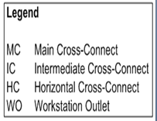
C = Cross-Connect; O = Outlet
C = Cross-Connect

Slide 36
Work Outlet (Area)
HC
Horizontal Cabling
WO
VC
EF
Entrance Facilities
TC
Telecommunication Closet
MDF = MC = MER =CD
Figure 3-40 TIA/EIA structured cabling in a building

Slide 37
Main Distribution Frame (MDF)
The MC (Main Cross-connect) usually connects two or more buildings and it is typically the central telecommunications connection point for a campus or building. It is also called the Main Distribution Frame (MDF) or Main Equipment Room (MER). The MC connects to Telco, an ISP, etc. Another term for the MC is the Campus Distributor (CD).

Slide 38
Main Distribution Frame (MDF)
The MC (M__n Cr___-connect) usually connects two or more buildings and it is typically the central telecommunications connection point for a campus or building. It is also called the M__n Di________n F____e (MDF) or M__n E_____t R__m (MER). The MC connects to Telco, an ISP, etc. Another term for the MC is the Ca____s Di________r (CD).

Slide 39
Main Distribution Frame (MDF)
The MC (Main Cross-connect) usually connects two or more buildings and it is typically the central telecommunications connection point for a campus or building. It is also called the Main Distribution Frame (MDF) or Main Equipment Room (MER). The MC connects to Telco, an ISP, etc. Another term for the MC is the Campus Distributor (CD).

Slide 40
Six (6) Subsystems of a Structured Cabling System Of EIA/TIA 568B
Within the EIA/TIA 568B standard are guidelines defining the six (6) subsystems of a structured cabling system.
(1) Building Entrance (Entrance Facilities) – point where the outdoor cabling interconnects with the internal building cabling, also called the Entrance Facilities (EF). Both public and private network cables enter the building at this point.
(2) Equipment Room (ER) – A room set-aside for complex electronic equipment such as the network servers and telephone equipment

Slide 41
Work Outlet (Area)
HC
Horizontal Cabling
WO
VC
EF
Entrance Facilities
TC
Telecommunication Closet
MDF = MC = MER =CD

Slide 42
Six (6) Subsystems of a Structured Cabling System Of EIA/TIA 568B
(3) Backbone Cabling – cabling that interconnects telecommunication closets, equipment rooms, and cabling entrances in the same building and between buildings.
(4) Telecommunications Closet (TC)– location of the cabling termination points that includes the mechanical terminations and the distribution frames. The connection of the horizontal cabling to the backbone wiring is made at this point. This is also called the Telecommunications Room (TR) or Telecommunications Enclosure (TE).
(TC = TR = TE)

Slide 43
Six (6) Subsystems of a Structured Cabling System Of EIA/TIA 568B
(3) Backbone Cabling – cabling that interconnects telecommunication closets, equipment rooms, and cabling entrances in the same building and between buildings.
(4) Te___________s Cl____t (TC)– location of the cabling termination points that includes the mechanical terminations and the distribution frames. The connection of the horizontal cabling to the backbone wiring is made at this point. This is also called the Te____________s R__m (TR) or Te__________s E_____e (TE).
(TC = TR = TE)

Slide 44
Six (6) Subsystems of a Structured Cabling System Of EIA/TIA 568B
(3) Backbone Cabling – cabling that interconnects telecommunication closets, equipment rooms, and cabling entrances in the same building and between buildings.
(4) Telecommunications Closet (TC)– location of the cabling termination points that includes the mechanical terminations and the distribution frames. The connection of the horizontal cabling to the backbone wiring is made at this point. This is also called the Telecommunications Room (TR) or Telecommunications Enclosure (TE).
(TC = TR = TE)

Slide 45
Work Outlet (Area)
HC
Horizontal Cabling
WO
VC
EF
Entrance Facilities
TC
Telecommunication Closet
MDF = MC = MER =CD
Figure 3-40 TIA/EIA structured cabling in a building

Slide 46
Six (6) Subsystems of a Structured Cabling System Of EIA/TIA 568B
(5) Horizontal Cabling (HC) - cabling that extends out from the Telecommunications Closet (TC) into the LAN work area. Typically, the horizontal wiring is structured in a star configuration running to each TCO or TeleCommunications Outlet, which is the wall plate where the twisted-pair cable terminates in the room. In some cases, the TCO terminates telephone, fiber, and video in addition to data into the same wall plate. (TCO= WO)
(6) Work Area - this is the location of the computers and printers, patch cables, jacks, computer adapter cables, and fiber jumpers.

Slide 47
Six (6) Subsystems of a Structured Cabling System Of EIA/TIA 568B
(5) Horizontal Cabling (HC) - cabling that extends out from the Telecommunications Closet (TC) into the LAN work area. Typically, the horizontal wiring is structured in a star configuration running to each TCO or T___C__________s O_____t, which is the wall plate where the twisted-pair cable terminates in the room. In some cases, the TCO terminates telephone, fiber, and video in addition to data into the same wall plate. (TCO= WO)
(6) Work Area - this is the location of the computers and printers, patch cables, jacks, computer adapter cables, and fiber jumpers.

Slide 48
Six (6) Subsystems of a Structured Cabling System Of EIA/TIA 568B
(5) Horizontal Cabling (HC) - cabling that extends out from the Telecommunications Closet (TC) into the LAN work area. Typically, the horizontal wiring is structured in a star configuration running to each TCO or TeleCommunications Outlet, which is the wall plate where the twisted-pair cable terminates in the room. In some cases, the TCO terminates telephone, fiber, and video in addition to data into the same wall plate. (TCO= WO)
(6) Work Area - this is the location of the computers and printers, patch cables, jacks, computer adapter cables, and fiber jumpers.

Slide 49
HC
WO
EF
TC
MDF = MC = MER =CD
Figure 3-40 TIA/EIA structured cabling in a building

Slide 50
Work Outlet (Area)
HC
Horizontal Cabling
WO
EF
Entrance Facilities
TC
Telecommunication Closet
MDF = MC = MER =CD
Figure 3-40 TIA/EIA structured cabling in a building

Slide 51
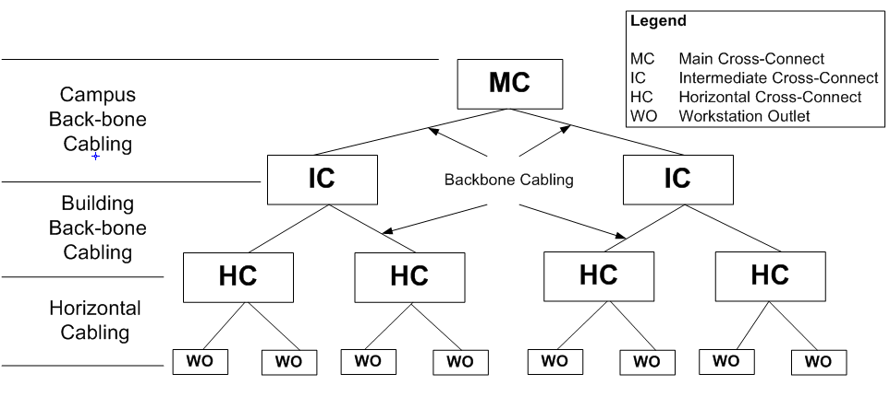
Terminology of Cabling & Cabling Devices (excluding spaces and rooms)
Main
Building
Floor

Slide 52
C = Cross-Connect; O = Outlet
C = Cross-Connect

Slide 53
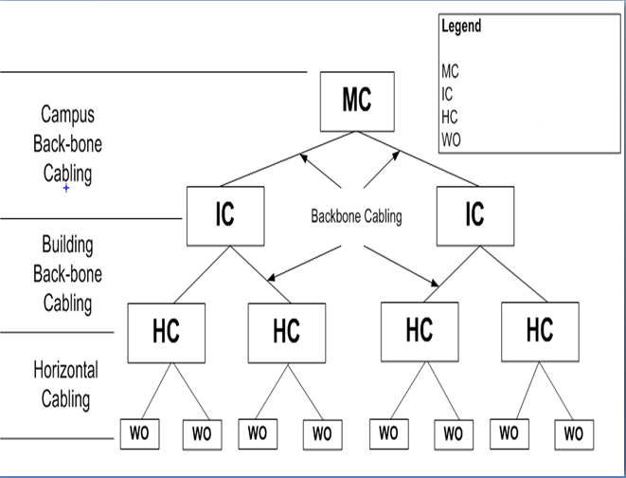
What do MC, IC, HC and WO Stand for In The Following Diagram?
Can YOU Answer The Question Above?
(MC -> IC -> HC -> WO)

Slide 54
C = Cross-Connect; O = Outlet
C = Cross-Connect

Slide 55
Terminology of Cabling & Cabling Devices (excluding spaces and rooms)
Main
Building
Floor

Slide 56
The Campus Network
Topology Hierarchy : MC
(MC, IC, HC, & WO) (MC=MDF=MER=CD)
The MC (Main Cross-connect) usually connects two or more buildings and it is typically the central telecommunications connection point for a campus or building. It is also called the Main Distribution Frame (MDF) or Main Equipment Room (MER). The MC connects to Telco, an ISP, etc. Another term for the MC is the Campus Distributor (CD).

Slide 57
The Campus Network
Topology Hierarchy : IC
(IC Intermediate Cross-connect = BD, Building Distributor)
The IC (Intermediate Cross-connect), is also called the Building Distributor (BD) and is the buildings connection point to the campus backbone. The IC links the MC to the Horizontal Cross-connect (HC)
(IC = BD)

Slide 58
The Campus Network
Topology Hierarchy : IC
(IC Intermediate Cross-connect = BD, Building Distributor)
The IC (In________e C_____-connect), is also called the Bu_______g Di________r (BD) and is the buildings connection point to the campus backbone. The IC links the MC to the Ho______l C___-connect (HC)
(IC = BD)

Slide 59
The Campus Network
Topology Hierarchy : IC
(IC = BD)
The IC (Intermediate Cross-connect), is also called the Building Distributor (BD) and is the buildings connection point to the campus backbone. The IC links the MC to the Horizontal Cross-connect (HC)
(IC = BD)

Slide 60
The Campus Network
Topology Hierarchy : HC
(HC, Horizontal Cross-connect = FD, Floor Distributor)
The HC (Horizontal Cross-connect) connection between the building distributors and the horizontal cabling to the work area or WO(Workstation Outlet). Another term used for the HC is the Floor Distributors - FD) (HC = FD)

Slide 61
The Campus Network Topology Hierarchy:
From Horizontal Cross-connects
to Workstation Outlet (WO=TO=TCO)
The WO (Workstation or Work-area Outlet) also called the TO = TCO (TeleCommunications Outlet) = is used to connect devices to the cable plant. The cable type typically used is CAT3, CAT5, CAT5e, CAT6, CAT6A, and various coaxial cables. Devices typically connected to these outlets are PCs, printers, servers, phones, televisions, wireless access points, etc.

Slide 62
HC
WO
VC
EF
TC
MDF = MC = MER =CD
Figure 3-40 TIA/EIA structured cabling in a building

Slide 63
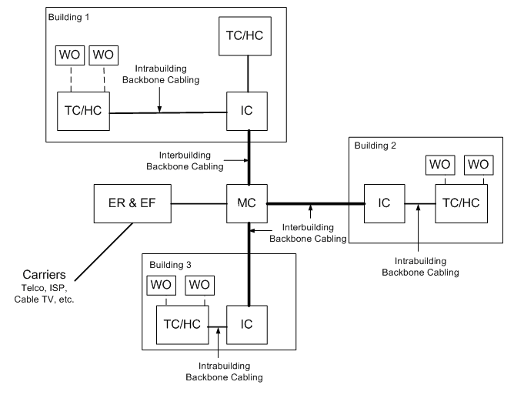
The BIG PICTURE
The Telecommunications Cabling System Architecture (Physical Layout) [TC=HC]
ER=Equipment Room
EF= Entrance Facilities
TC=Telecommunication Closet

Slide 64
TC/HC = Telecommunication Closet/Horizontal Cabling= Horizontal Cross-Connect
ER = Equipment Room
EF= Entrance Facilities

Slide 65
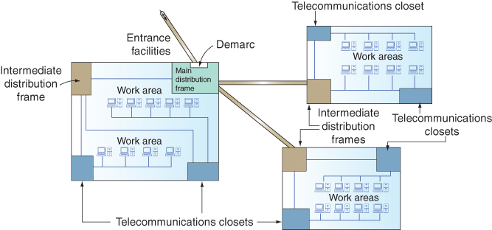
TC/HC
EF
TC
IC
IC
TC
TC/HC
TC
IC
TC
TC
TC/HC
TC
Figure 3-39 TIA/EIA Structured Cabling in an enterprise
Network+ Guide to Networks, 5th Edition

Slide 66
HC
WO
EF
TC
MDF = MC = MER =CD
Figure 3-40 TIA/EIA structured cabling in a building

Slide 67
Work Outlet (Area)
HC
Horizontal Cabling
WO
EF
Entrance Facilities
TC
Telecommunication Closet
MDF = MC = MER =CD
Figure 3-40 TIA/EIA structured cabling in a building

Slide 68

The Following Slides Deal with HC, or
TC to LAN Connectivity
HC = Horizontal Cabling
TC = Telecommunication Closet

Slide 69
Horizontal Cabling
(TC to LAN)
Permanent network cabling within a building is considered to be horizontal cabling
This is defined as the cabling that extends out from the Telecommunications Closet (TC) into the LAN work area.

Slide 70
Horizontal Cabling
(HC has 7 components)
Take time to plan for your horizontal cabling installation, this is where your network interfaces with the users.
There is always a substantial installation cost associated with horizontal cabling and there is an even greater cost of having to replace or upgrade a cable installation.
You don’t want to have re-cable your system very often.
Careful attention should be given to planning for the Horizontal Cabling of a LAN. Make sure that you fully understand your current networking needs and that your proposed plan meets the needs. Also, make sure your plan addresses future needs and growth of your network.

Slide 71
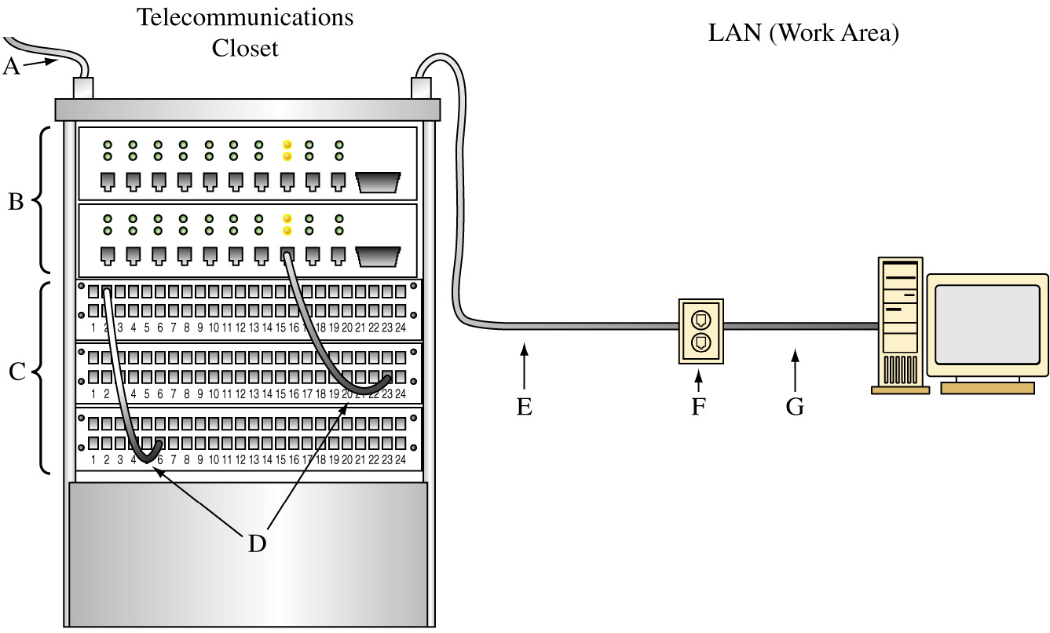
The Seven (7) Basic Blocks of Horizontal Cabling: (A) (Backbone)
A. Backbone Cabling

Slide 72
The Seven (7) Basic Blocks of Horizontal Cabling: (B) (Switch) or (Hub)
B. Switch or Hub

Slide 73
The Seven (7) Basic Blocks of Horizontal Cabling: (C ) (Patch Panel)
C. Patch Panels

Slide 74
The Seven (7)Basic Blocks of Horizontal Cabling: (D) (Patch Cable)
D. Patch Cables

Slide 75
The Seven (7) Basic Blocks of Horizontal Cabling: (E) (Cabling to LAN)
E. Cabling to the LAN

Slide 76
The Seven (7) Basic Blocks of Horizontal Cabling: (F ) (Wall Plate)
F. Wall Plate

Slide 77
The Basic Blocks of Horizontal Cabling: (G) (Patch Cable)
G. Patch cable connecting the computer to the wall plate

Slide 78
The 7 Basic Blocks of Horizontal Cabling (from TC to WO)
(Can You Name A, B, C, D, E, F & G?
How Many Patch Cables We Need?)

Slide 79
The Basic Blocks of Horizontal Cabling: (A) = ?
A. ?

Slide 80
The Seven (7) Basic Blocks of Horizontal Cabling: (A) (Backbone)
A. Backbone Cabling

Slide 81
The Basic Blocks of Horizontal Cabling: (B) = ?
B. ?

Slide 82
The Seven (7) Basic Blocks of Horizontal Cabling: (B) (Switch) or (Hub)
B. Switch or Hub

Slide 83
The Basic Blocks of Horizontal Cabling : (C ) =?
C. ?

Slide 84
The Seven (7) Basic Blocks of Horizontal Cabling: (C ) (Patch Panel)
C. Patch Panels

Slide 85
The Basic Blocks of Horizontal Cabling : (D) = ?
D. ?

Slide 86
The Seven (7)Basic Blocks of Horizontal Cabling: (D) (Patch Cable)
D. Patch Cables

Slide 87
The Seven (7) Basic Blocks of Horizontal Cabling: (E) (Cabling to LAN)
E.

Slide 88
The Seven (7) Basic Blocks of Horizontal Cabling: (E) (Cabling to LAN)
E. Cabling to the LAN

Slide 89
The Seven (7) Basic Blocks of Horizontal Cabling: (F ) (Wall Plate)
F.

Slide 90
The Seven (7) Basic Blocks of Horizontal Cabling: (F ) (Wall Plate)
F. Wall Plate

Slide 91
The Basic Blocks of Horizontal Cabling: (G) (Patch Cable)
G.

Slide 92
The Basic Blocks of Horizontal Cabling: (G) (Patch Cable)
G. Patch cable connecting the computer to the wall plate

Slide 93
The Basic Blocks of Horizontal Cabling: (A) = ?
A. ?

Slide 94
The Basic Blocks of Horizontal Cabling: (B) = ?
B. ?

Slide 95
The Basic Blocks of Horizontal Cabling : (C ) =?
C. ?

Slide 96
The Basic Blocks of Horizontal Cabling : (D) = ?
D. ?

Slide 97
The Seven (7) Basic Blocks of Horizontal Cabling: (E) (Cabling to LAN)
E.

Slide 98
The Basic Blocks of Horizontal Cabling : (F) = ?
F. ?

Slide 99
The Basic Blocks of Horizontal Cabling: (G) = ?
G. ?

Slide 100
The 7 Basic Blocks of Horizontal Cabling (from TC to WO)
(Can You Name A, B, C, D, E, F & G?
How Many Patch Cables We Need?)

Slide 101
The Seven (7) Basic Blocks of Horizontal Cabling: (A) (Backbone)
A. Backbone Cabling

Slide 102
The Seven (7) Basic Blocks of Horizontal Cabling: (B) (Switch) or (Hub)
B. Switch or Hub

Slide 103
The Seven (7) Basic Blocks of Horizontal Cabling: (C ) (Patch Panel)
C. Patch Panels

Slide 104
The Seven (7)Basic Blocks of Horizontal Cabling: (D) (Patch Cable)
D. Patch Cables

Slide 105
The Seven (7) Basic Blocks of Horizontal Cabling: (E) (Cabling to LAN)
E. Cabling to the LAN

Slide 106
The Seven (7) Basic Blocks of Horizontal Cabling: (F ) (Wall Plate)
F. Wall Plate

Slide 107
The Basic Blocks of Horizontal Cabling: (G) (Patch Cable)
G. Patch cable connecting the computer to the wall plate

Slide 108
Chapter 2-2 Key Terms
EIA
TIA
Campus Network
EIA/TIA 568B

Slide 109
Chapter 2-2 Key Terms
Building Entrance (Entrance Facilities) (EF)
Equipment Room (ER)
Backbone Cabling
Telecommunications Closet (TC)
Horizontal Cabling (HC)
Work Area Workstation Outlet (WO)

Slide 110
Chapter 2-2 Key Terms
Terminated
Patch Cable

